Slide 1
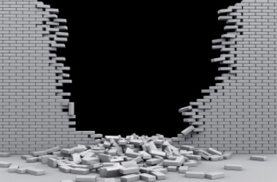
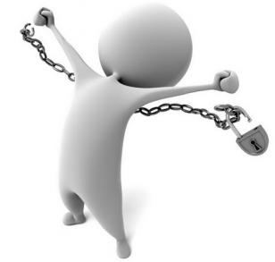
The Forgiveness Project
It’s Time to Tear Down Those Walls
And
Break the Chains!
First Nazareth Baptist Church
P.E.A.C.E. Life Management Ministry

Slide 2

Using the ACCARE Model* to Work Towards Forgiveness
Agree with God’s Word to forgive
Commit to the process of forgiveness
Challenge doubt, negative self-talk, and negative thoughts
Apply relevant Scripture
Remain focused on God, who is Bigger and more Powerful than the offense and your offender
Expect the Lord to move as you stand on His promises
2015 L.D. Bessellieu, Ph.D.

Slide 3
Forgiveness
Psychologically:
a conscious, deliberate decision to release feelings of resentment or vengeance toward a person or group who has harmed you, regardless of whether they actually deserve your forgiveness.
verb \fər-ˈgiv, fȯr-\
to stop feeling anger toward (someone who has done something wrong) : to stop blaming (someone)
to stop feeling anger about (something) : to forgive someone for (something wrong)
to stop requiring payment

Slide 4
Forgiveness
Does not mean that what was done to you is “ok”.
It does not mean you are giving your offender a “pass”, or you’re letting them “off the hook”.
Withholding forgiveness is not a viable or effective punishment. The offender is still not accountable or responsible to you just because you refuse to forgive him or her.
Withholding forgiveness is the equivalent of self-harm, as you hold on to anger, bitterness, resentment, etc
Although forgiveness can lead to reconciliation, it is not a guarantee of reconciliation, unless the Lord directs you in this direction.

Slide 5
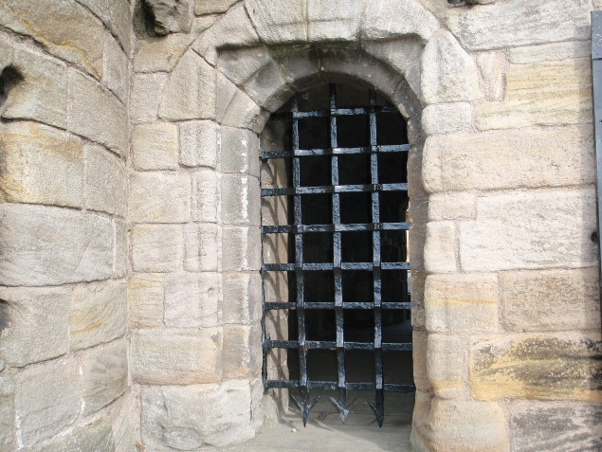
A brother offended is harder to be won over than a strong city , and [their] contentions separate them like the bars of a castle. Proverbs 18:19 (Amplified Version)

Slide 6
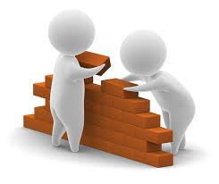
Potential Impact of Unforgiveness
BUILD
WALLS
JUSTIFY
REJECT
WISE
COUNSEL
PRIDE
FEEL DISCONNECTED
FROM
GOD

Slide 7
Learning to forgive allows you to turn that “hot” memory into simply a “bad” memory
Hot
Memory
Bad Memory

